Slide 1


Unit 1: Lesson 2 Kid of the year

Slide 2
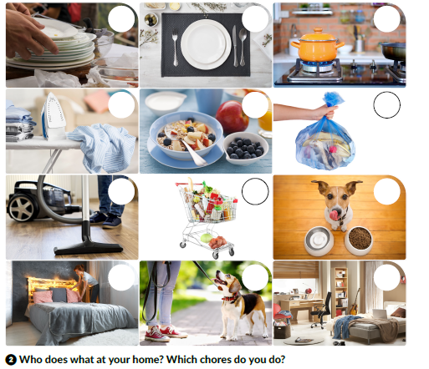
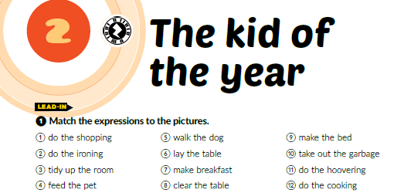
Textbook p. 16
Task ❶ Match the expressions to the pictures.
8
6
12
2
7
10
11
1
4
9
5
3
Task ❷ Who does what at your home?
Which chores do you do?

Slide 3
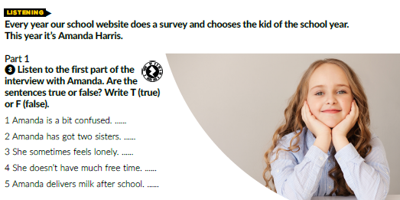
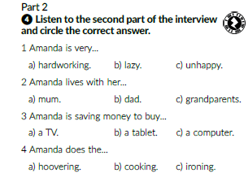
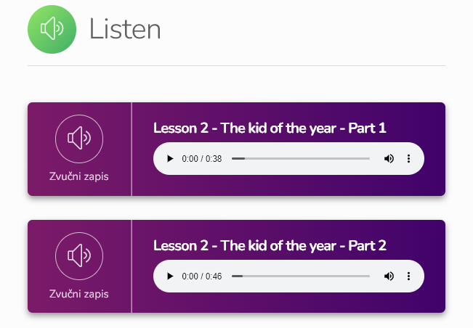
Task ❸ Listen to the first part of the interview with Amanda. Are the sentences true or false? Write T (true) or F (false).
Task ❹ Listen to the first part of the interview. Circle the correct answer
T
F
T
T
F
https://www.e-sfera.hr/dodatni-digitalni-sadrzaji/31eb5685-7ae3-4de8-8bac-6b53d34d9469/

Slide 4
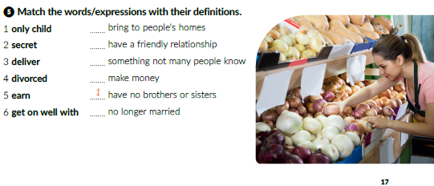
Task❺ Match the words/expressions with their definitions.
3
6
2
5
4
Task ❻ Choose the kid of the year in your class and interview him/her. Write down the questions before the interview.

Slide 5
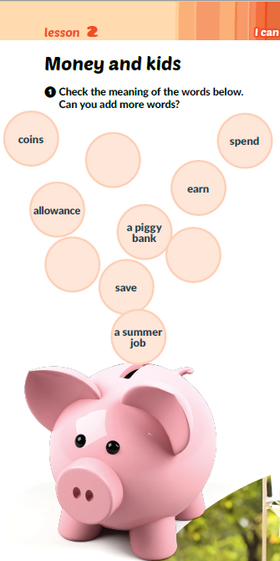
Texbook p. 18
Task ❶ Check the meaning of the words in circles. Can you add more words?
bank
account
Euro
pay

Slide 6
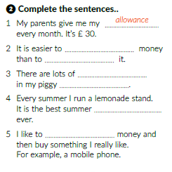
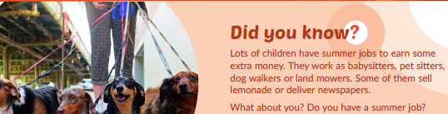
spend
earn
coins
bank
job
save

Slide 7
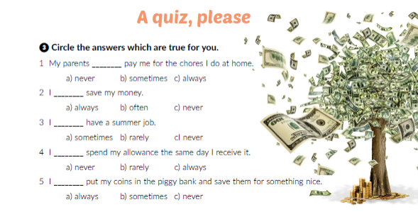
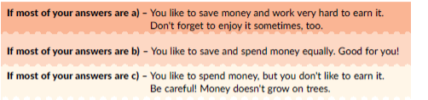

Slide 8
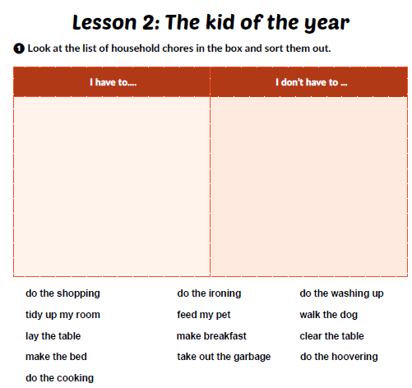
Workbook p. 10
Task ❶ Look at the list of household chores in the box and sort them out.

Slide 9
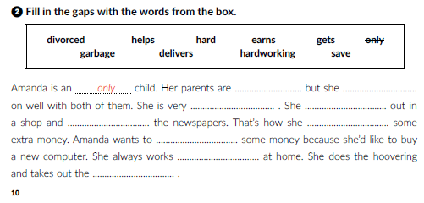
divorced
gets
hardworking
helps
delivers
earns
save
hard
garbage
Workbook p. 10
Task ❷ Fill in the gaps with the words from the box.

Slide 10
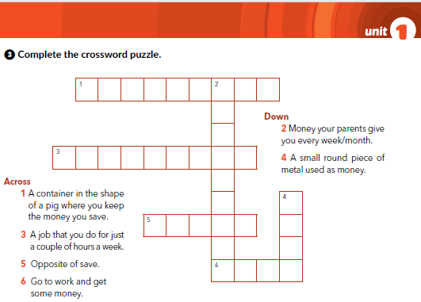
P I G G Y B A N K
L
L
O
W
A
N
C
E
Workbook p. 11
S U M M E R J B
CO
I
S P E D
A R N

Slide 11
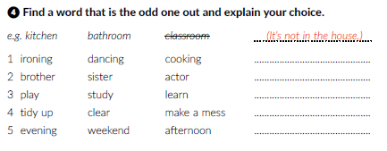
Workbook p. 11
Task ❹ Find a word that is the odd one out and explain your choice.
(It’s not a chore.)
(He is not a family member.)
(It’s not about school grades.)
(It’s opposite of cleaning.)
(It’s not part of the day.)

Slide 12
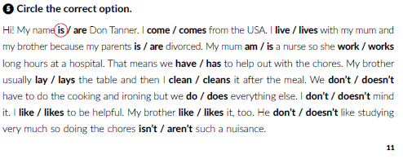
Workbook p. 11

Slide 13
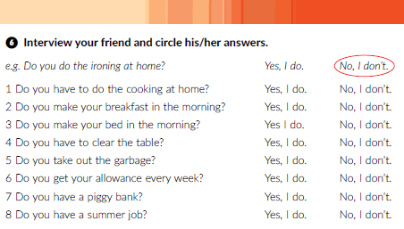
Workbook p. 12

Slide 14

Lesson 2 The kid of the year | Way to go 3 (e-sfera.hr)

